Slide 1
Physics informed
neural networks
PINN

Slide 2
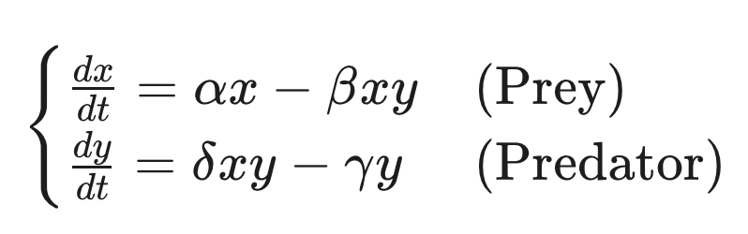
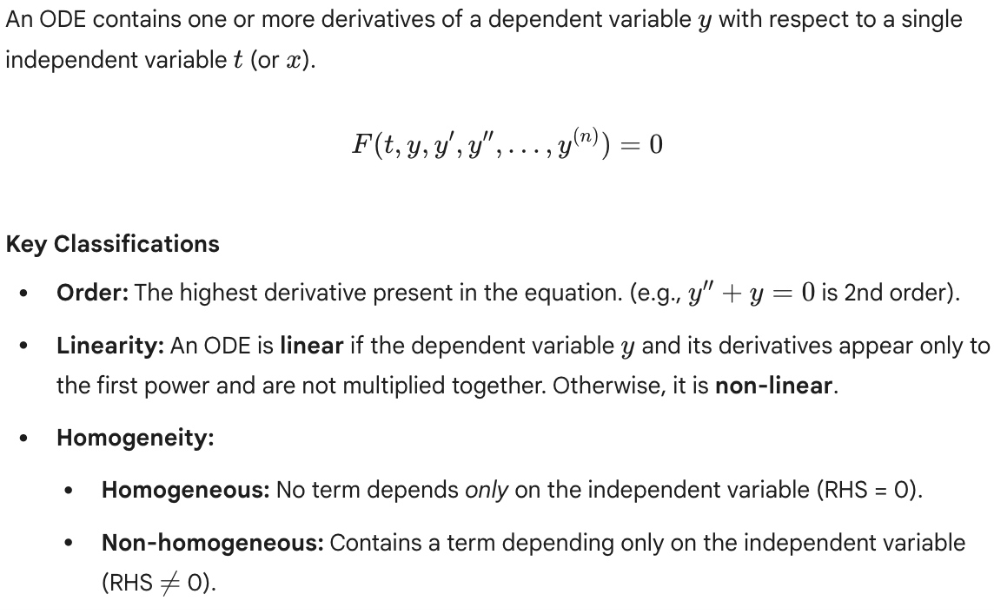
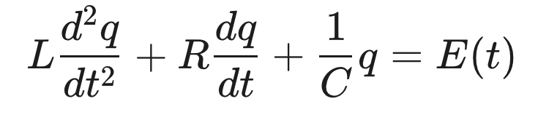

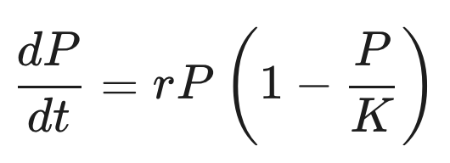
Ordinary differential equations

Slide 3
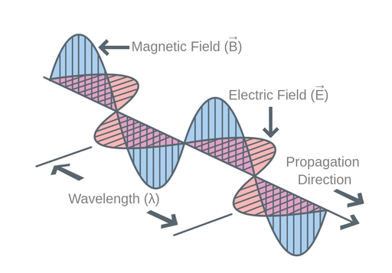
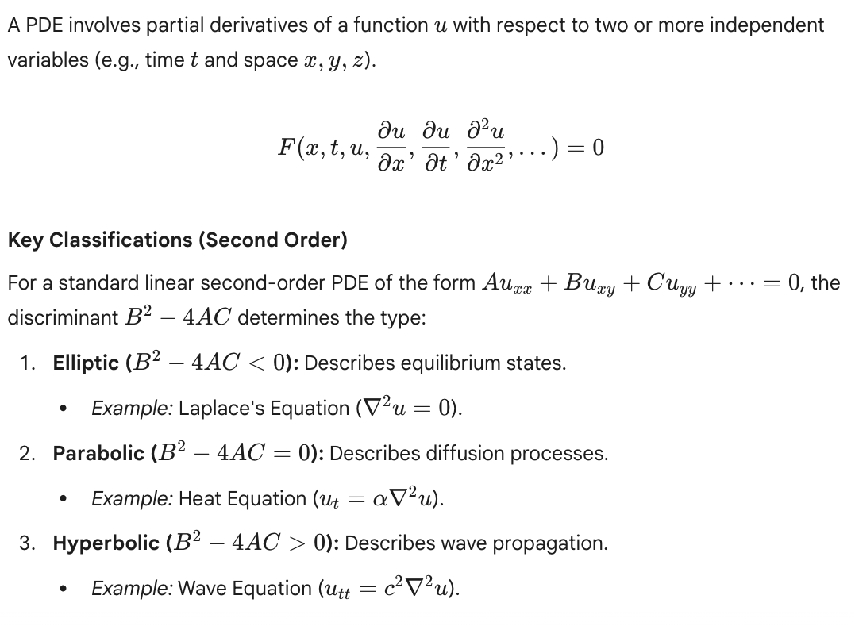
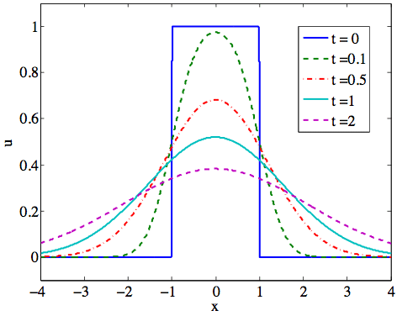
Partial differential equations

Slide 4
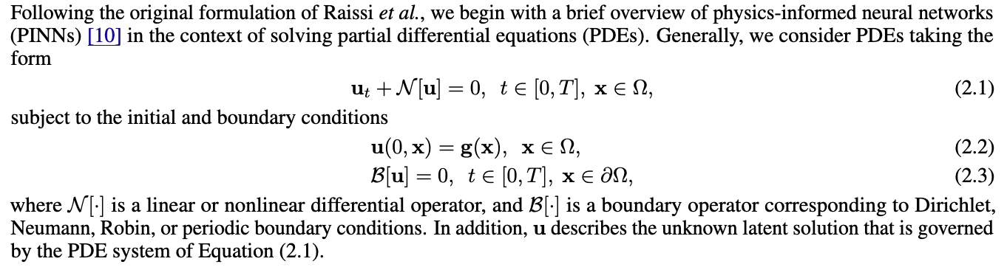
General formulation
https://arxiv.org/pdf/2308.08468

Slide 5
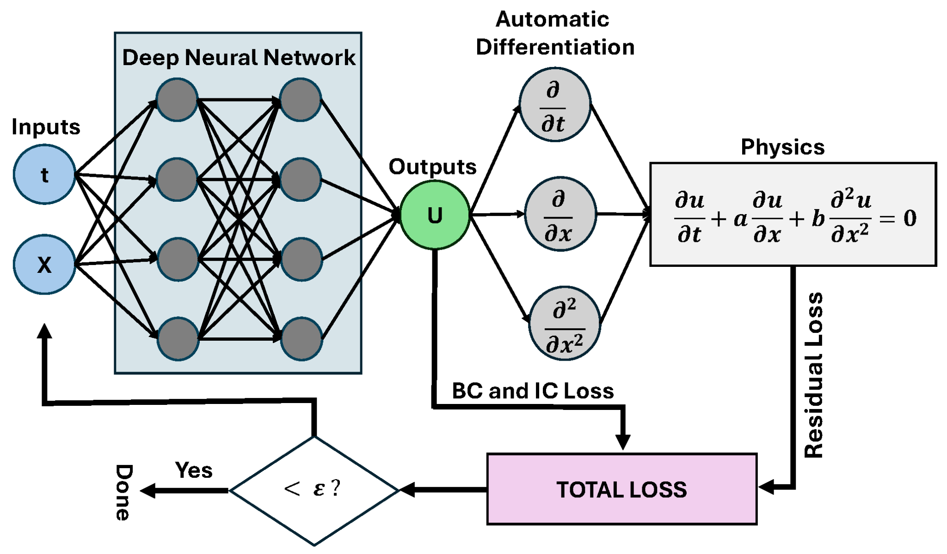
Solving with neural networks

Slide 6
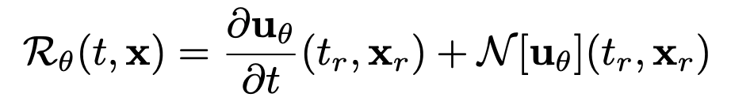
Residual
If we compare this residual with Equation (2.1), we know that it must be 0

Slide 7
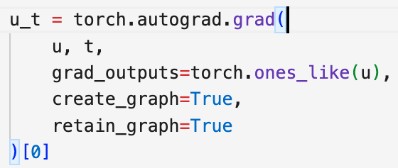
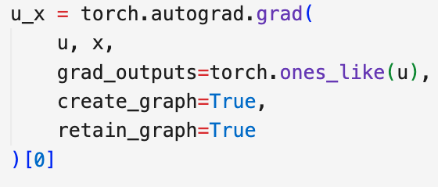
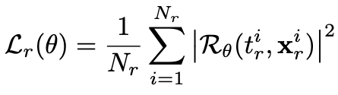
Residual loss
Using automatic differentiation, we can calculate the residual for each (t,x) in out training database, giving us the residual loss:

Slide 8

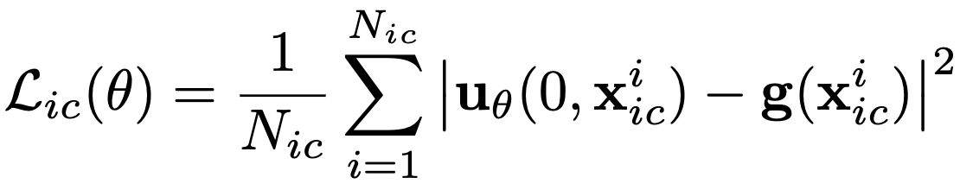
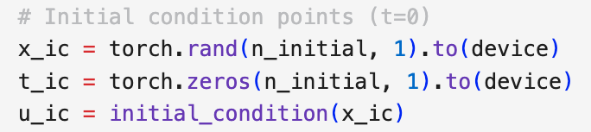
Initial condition
The initial condition is a function that must be replicated on t = 0 (ODE or PDE)
The loss here can be defined as the distance on t=0 to g(x):

Slide 9

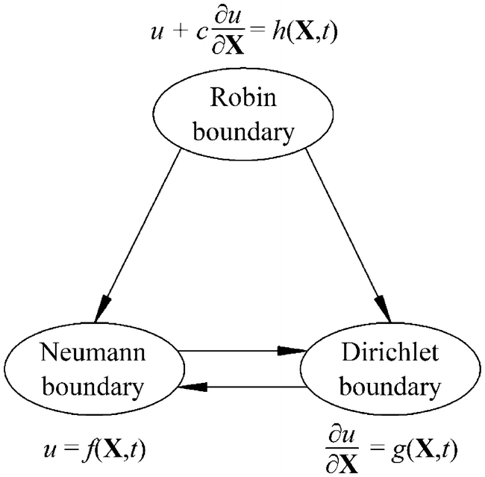
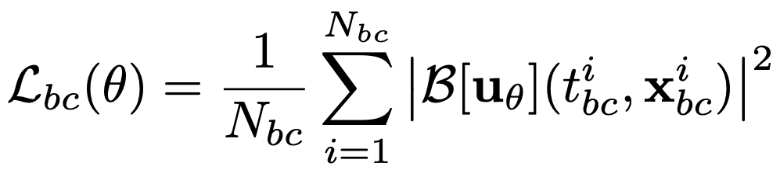
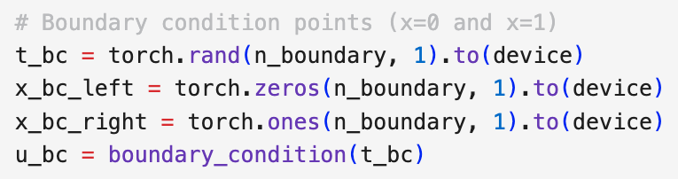
Boundary conditions
In a PDE, the boundary condition define how the function behaves in the boundary of the spatial domain. B[u(x,t)] must be zero for all t,x in boundary.

Slide 10

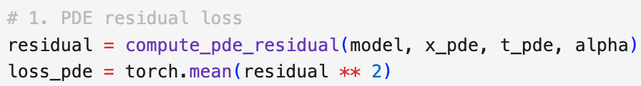
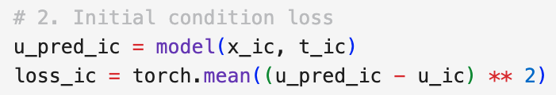
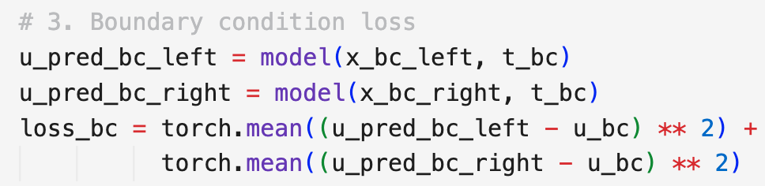

Error function
Equation
Initial condition
Boundary conditions

Slide 11
Training loop (see implementation)
For each step:
Compute points for boundary and initial conditions so we can evaluate the losses
Compute points uniformly on the domain so we can evaluate residual loss
Backpropagate the gradients from the loss
Update the parameters
Physics-informed neural networks: A deep learning framework for solving forward and inverse problems involving nonlinear partial differential equations - ScienceDirect

Slide 12
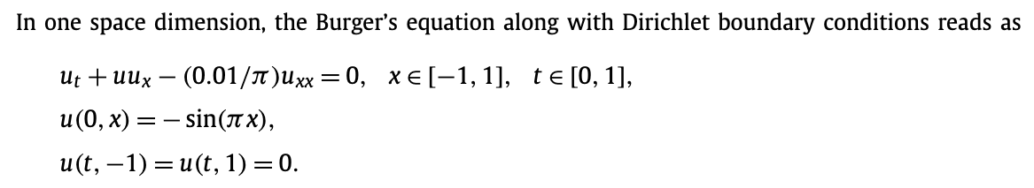
Burgers equation

Slide 13
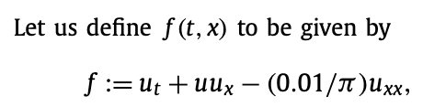
Burgers equation

Slide 14
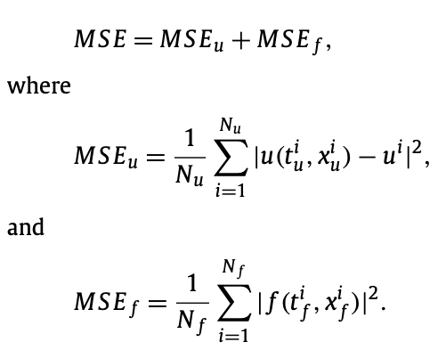
Burgers equation

Slide 15
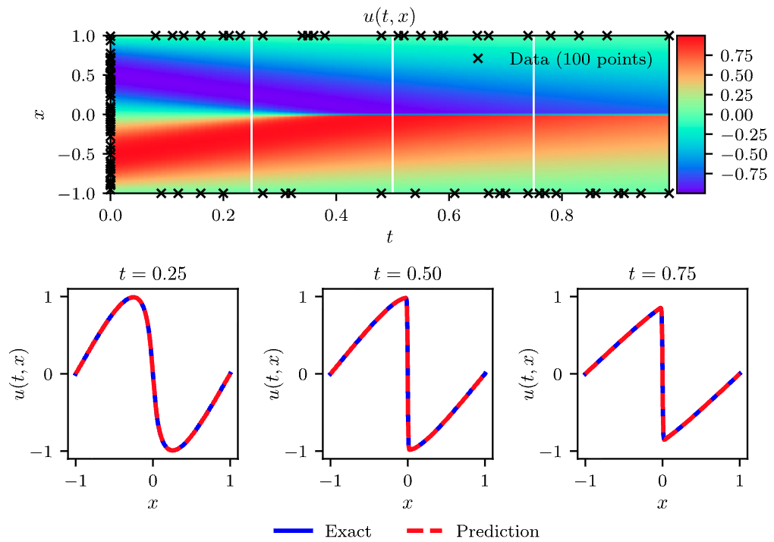
Burgers equation

Slide 16
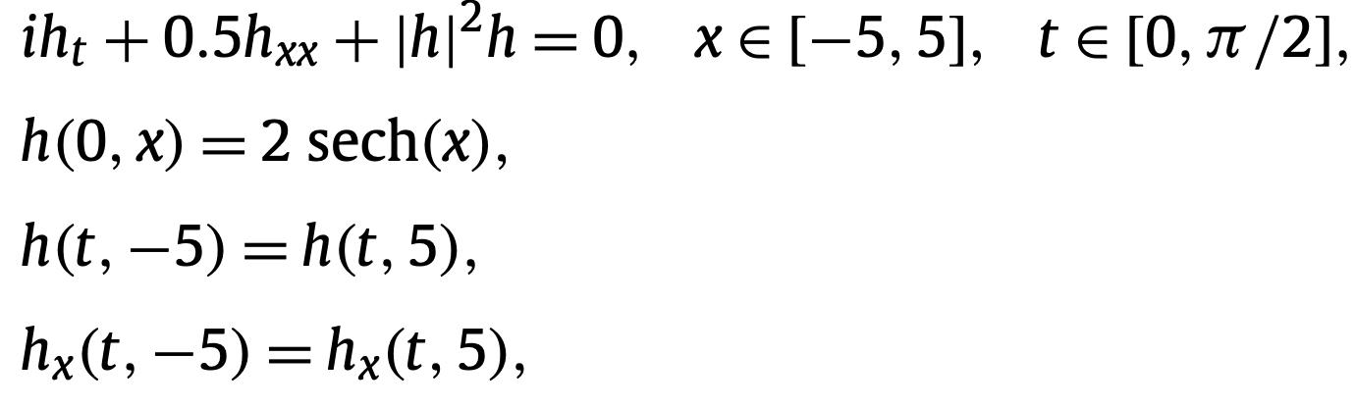
Schrödinger equations

Slide 17

Schrödinger equations

Slide 18
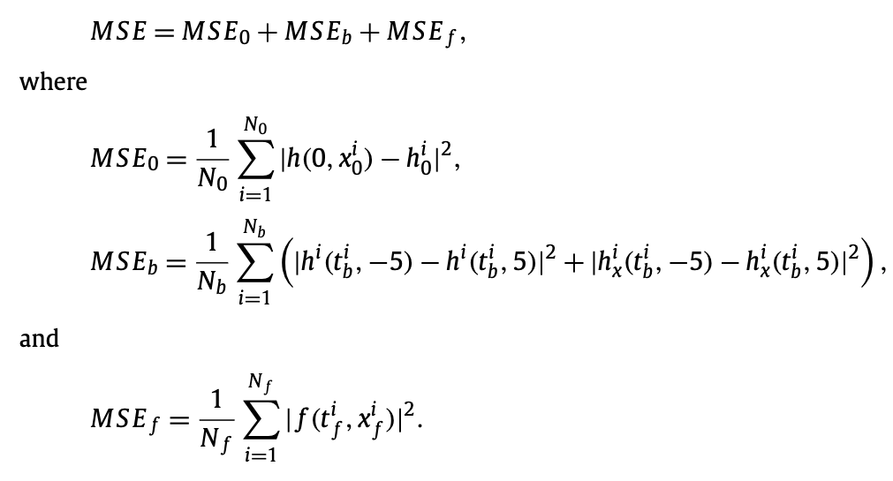
Schrödinger equations

Slide 19
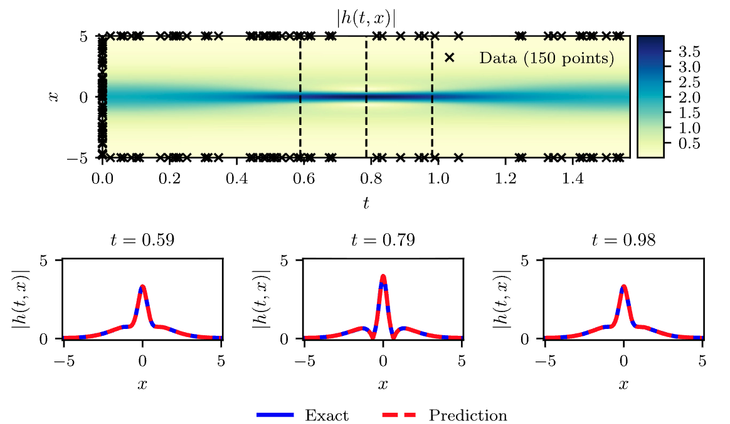
Schrödinger equations
(f evaluated on 20.000 points)

Slide 20
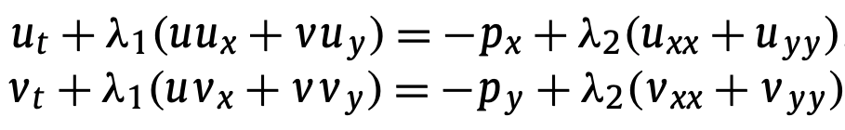

Navier-Stokes system of equations

Slide 21

Navier-Stokes system of equations

Slide 22
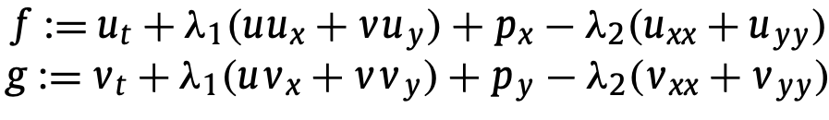
Navier-Stokes system of equations

Slide 23

Navier-Stokes system of equations
We approximate using:

Slide 24
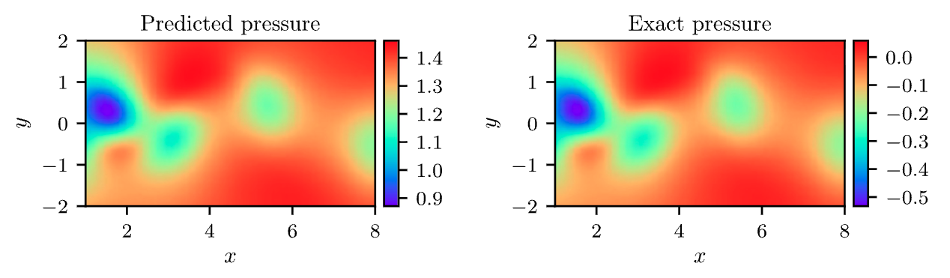
Navier-Stokes system of equations

Slide 25
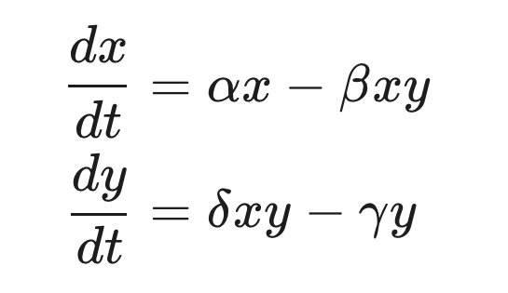
Exercises
Finish the implementation for burgers equation
Solve the following system of equations, known as Lotka-Volterra:

